Slide 1
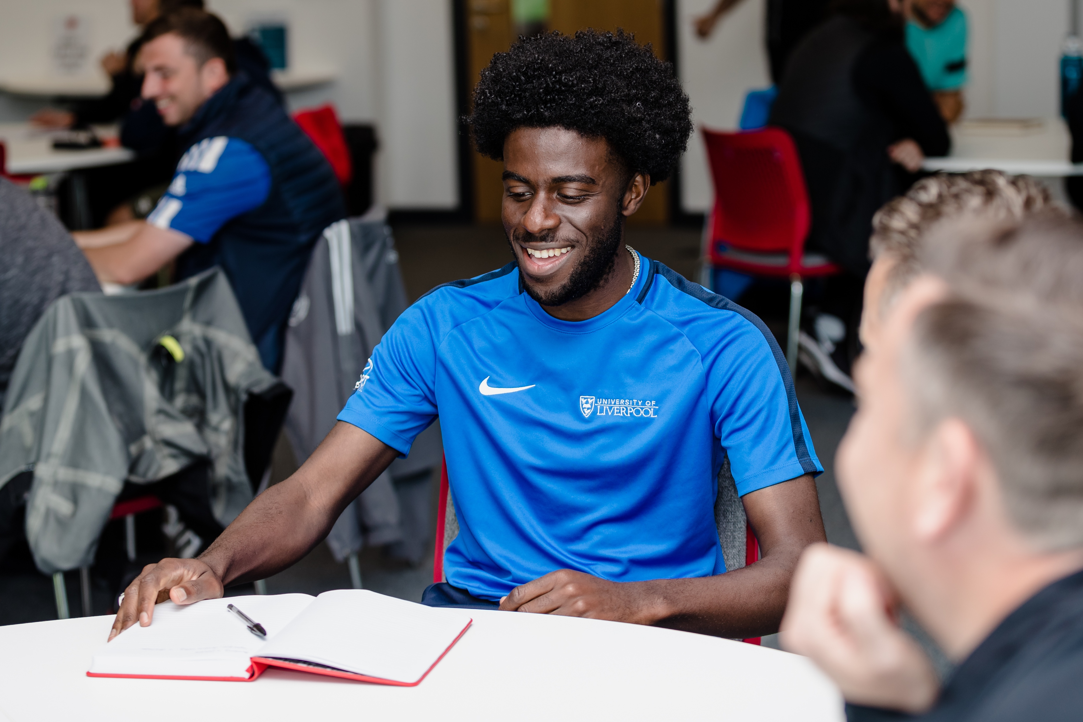
Skill
challenges
4 Resources

Slide 2
FAW
CICSTART FRAMEWORK
Passing Challenges
Aim: To encourage players to pass the ball using both feet and different surfaces of the foot.
Passing Challenges:
In pairs, challenge players to pass the ball using both feet from different distances (short and long; on the floor; and in the air)
Challenge players to pass the ball using both the inside and outside of both feet
Challenge the players to control and transfer the ball with one foot, before passing back to their partner with the other.
Use 2 cones to create a ‘gate’ and challenge the players to pass both through and around it with both feet
Position a ball on top of a cone between the ‘gate’ which players must try knock off by passing from different distances
Top Tips: Look at target; strike centre of ball; pass with good weight and accuracy; follow through towards target

Slide 3
FAW
CICSTART FRAMEWORK
Control Challenges
Aim: To encourage players to use different body parts to control the ball.
Control Challenges:
Challenge players to control the ball on the floor using both feet, using the inside and outside of their foot
Challenge players to control the ball on the bounce or out of the air, using both feet
Challenge players to control the ball with different body parts, e.g., chest and both thighs, to bring the ball under control
Challenge players to juggle the ball by 1) ‘bounce, kick, and catch’; or 2) ‘bounce and kick’; or 3) ‘kick and catch’
Challenge players to do ‘keepy uppies’ either with bounces, with limited bounces, or no bounces, utilising different body parts
Top Tips: Keep your eye on the ball; get in line with the ball; utilise different body parts; take soft touches to control.

Slide 4
FAW
CICSTART FRAMEWORK
Dribbling Challenges
Aim: To encourage players to dribble with both feet whilst keeping their head up
Dribbling Challenges:
Challenge the players to dribble the ball using both feet, whilst keeping their head up and the ball under close control.
Challenge the players to get as many touches as they can on the ball in a set time limit, showcasing different skills or moves
Challenge players to dribble in and out of cones in a straight line using different parts of the foot
Challenge players to dribble in and out of staggered cones in a ‘zig zag’ fashion to encourage a change of speed and direction
Challenge the players to master the 11 Welsh Way Moves, which they can view on the FAW YouTube channel: https://www.youtube.com/watch?v=eNRsHdcWZGE&list=PLoXh80deeO-lrhjJmHMZfuxFqR2_YgBQx
Top Tips: Keep the ball close; dribble with different parts of the foot; keep head up; change speed and direction with the ball.

Slide 5
FAW
CICSTART FRAMEWORK
Shooting Challenges
Aim: To encourage players to shoot on target using both feet with power and accuracy.
Shooting Challenges:
Challenge players to shoot into an empty goal with both feet (using inside, outside, and laces).
Position footballs on top of cones on the goal line, or tie bibs in the nets, and set them as targets for the players to try and hit.
Challenge players to hit both posts and/or the crossbar to test their shooting power and accuracy.
Challenge the players to shoot from different angles and distances, either from a static or moving position.
Add a goalkeeper and see how many goals the players can score in a set number of attempts.
Top Tips: Select surface to shoot (inside, outside, laces); follow through towards target; strike with power and accuracy

